Slide 1

Student Profile Management System
Fundamentals of Data Science - Presentation
Made by : Nirvik K.C.
1

Slide 2
Table of Contents
Introduction : Student Management System
Project Objectives : Project Goals
System Features : Key Features of Student Management System
Implementation : Development Journey
Sample Outputs : System Demonstration
Conclusion
2

Slide 3

Student Management System
Introduction
An application program that processes, save and mange student information.
Eliminate manual task and have provide a facility for educational institution to better the learning experience.
Aid to manage student information, academic process and activities outside the academic.
3

Slide 4
Objectives
Met usability and efficiency expectations.
Provided a basis for future projects.
Demonstrated organized code with regard to solving real world problems.
Demonstrated a best practice for educational software development.
4

Slide 5
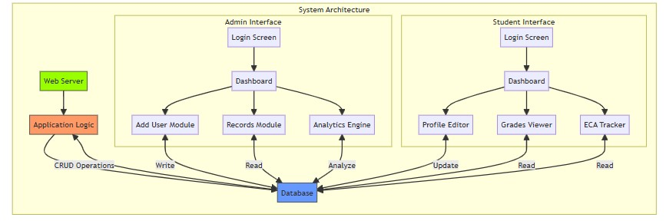
System Features
Figure : System Design for the Student Management System (HIX AI)
5

Slide 6
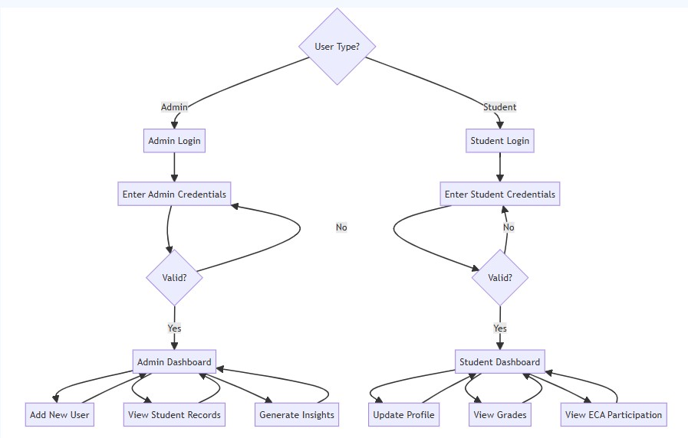
System Features
Figure : Flowchart for Student Management System (HIX AI)
6

Slide 7
Implementation
Contains User, Admin, Student, DataHandler classes.
Applies Object-Oriented programming principles.
Handles files, errors, and user input/output.
Provides login, logout, and data handling functionality.
7

Slide 8
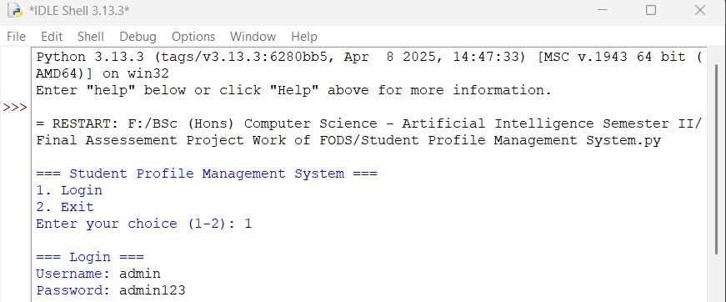
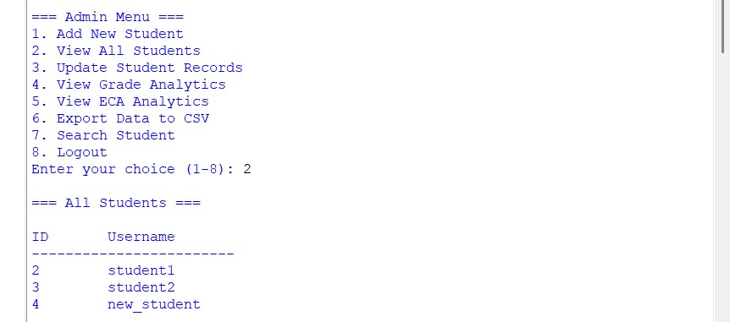
Sample Output
Admin Menu
8

Slide 9
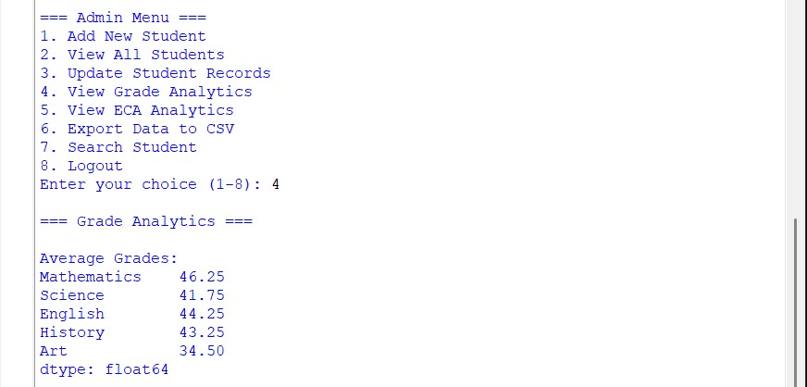
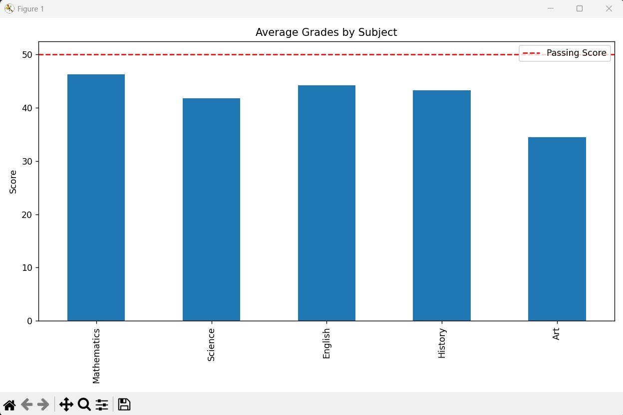
Sample Output
Admin Menu
9

Slide 10
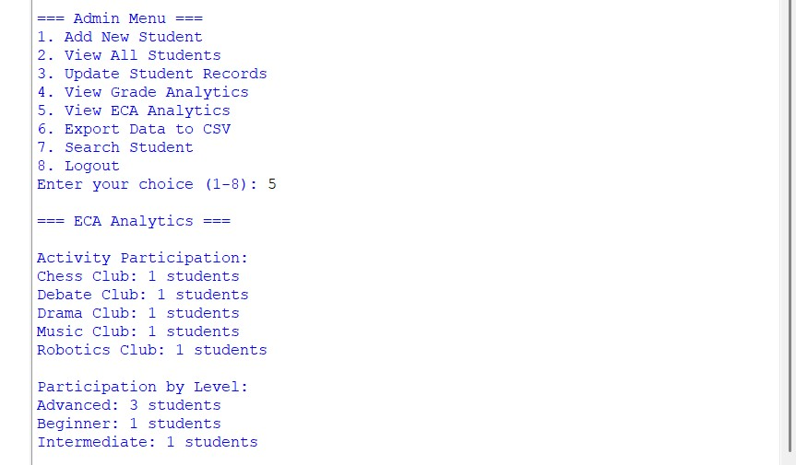
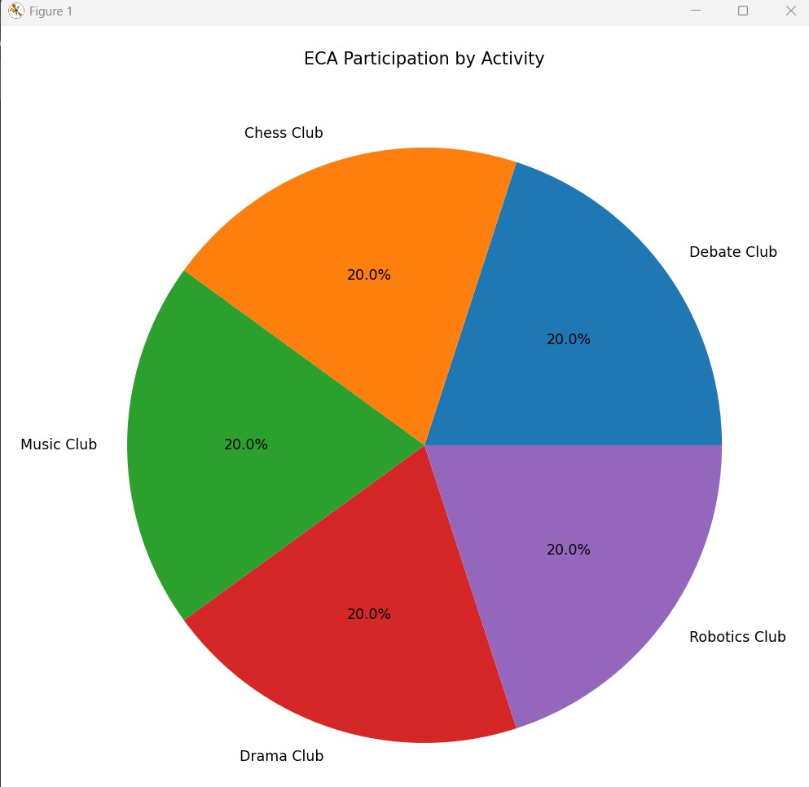
Sample Output
Admin Menu
10

Slide 11
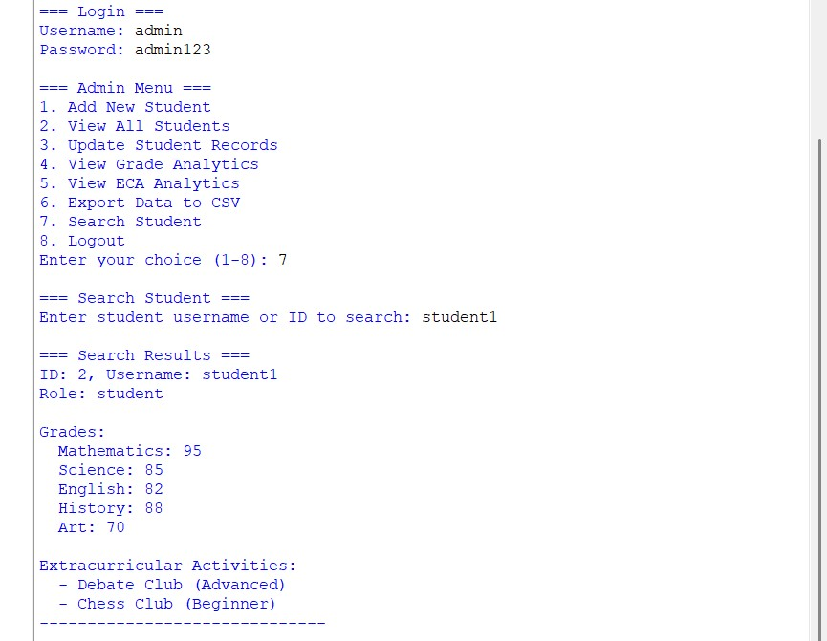
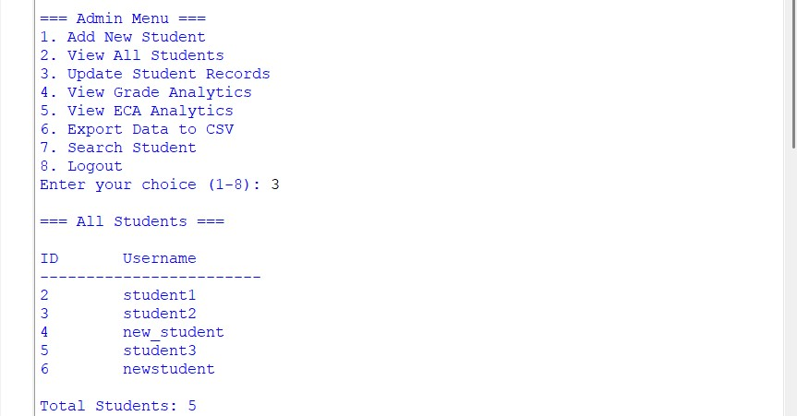
Sample Output
Admin Menu
11

Slide 12
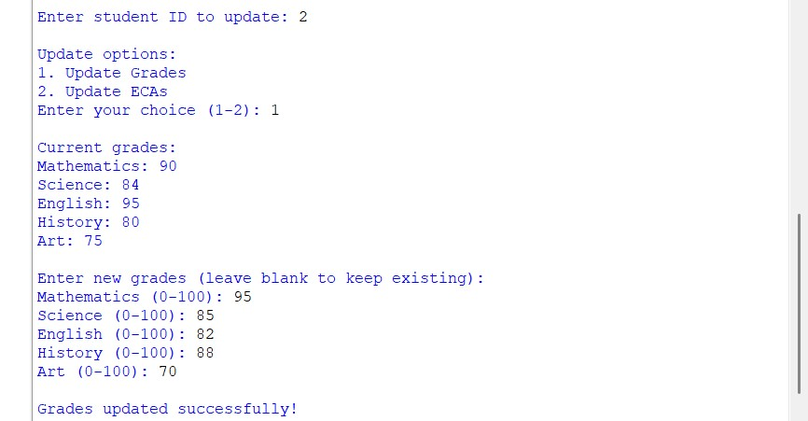
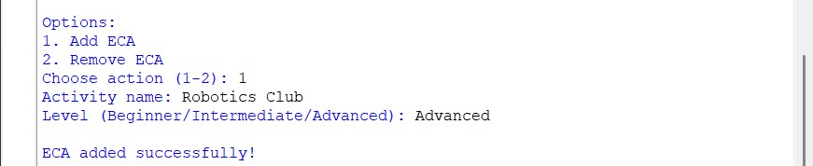
Sample Output
Admin Menu
12

Slide 13
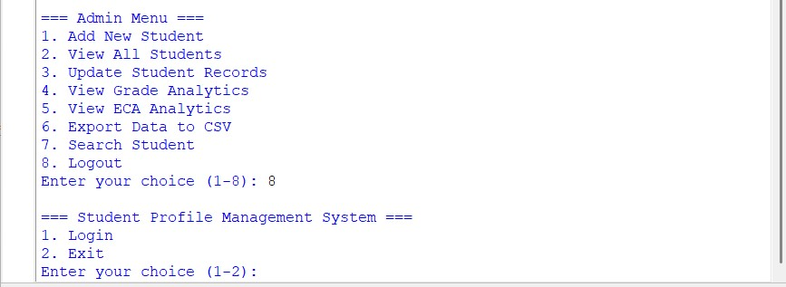
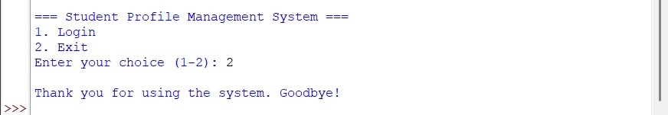
Sample Output
Admin Menu
13

Slide 14
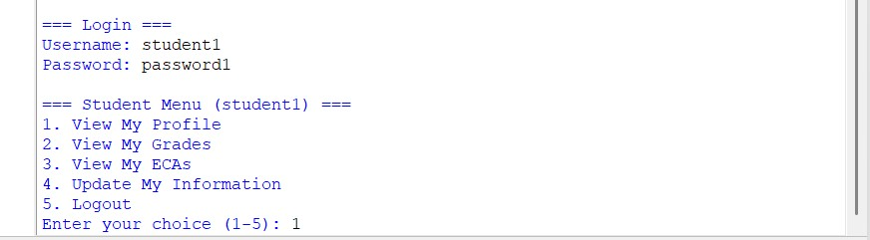
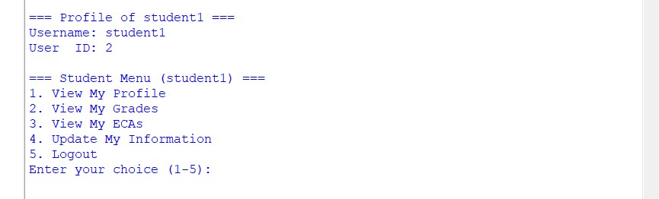
Sample Output
Student Menu
14

Slide 15
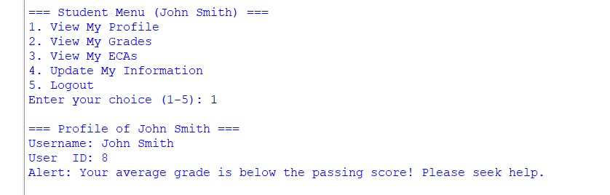
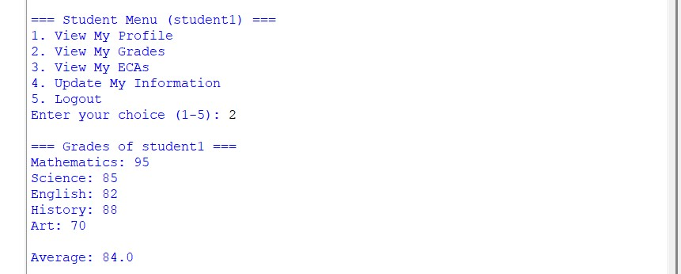
Sample Output
Student Menu
15

Slide 16
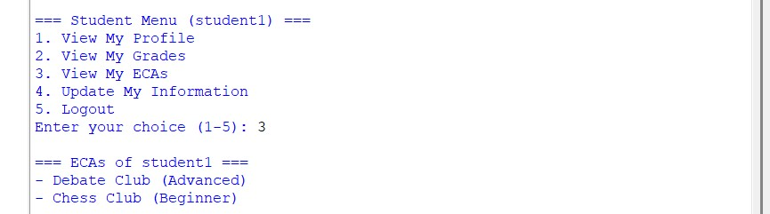
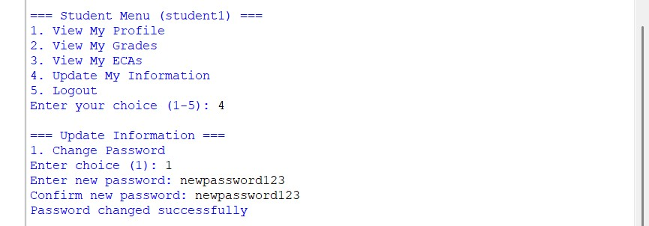
Sample Output
Student Menu
16

Slide 17
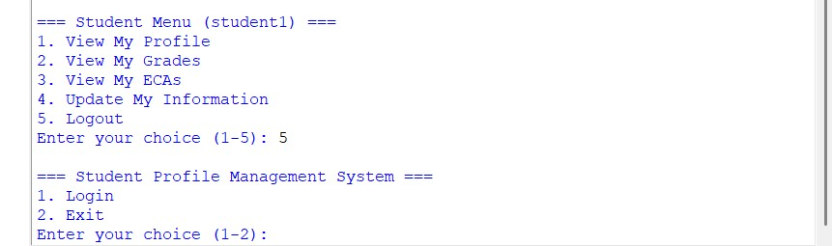
Sample Output
Student Menu
17

Slide 18
CONCLUSION
It automates student data management.
Uses modular OOP design.
Has the capability for error handing.
Further enhancement can be added onto this system.
18

Slide 19
References
Matuntuta, S. (2024) What is a Student Management System? Benefits & Guide Cloud Assess. 20 November 2024 [online]. Available from: https://cloudassess.com/blog/what-is-sms/ [Accessed 27 June 2025].
Anon. (no date) Scaler Topics [online]. Available from: https://www.scaler.com/topics/python/ [Accessed 27 June 2025].
Anon. (no date) Hix.ai [online]. Available from: https://hix.ai/deepseek-r1?id=cmcss494b00uhj4bi6806aaw8 [Accessed 27 June 2025].
Anon. (2019) GeeksforGeeks. 30 October 2019 [online]. Available from: https://www.geeksforgeeks.org/python/student-management-system-in-python/ [Accessed 1 July 2025].
Anon. (no date) Napkin.ai [online]. Available from: https://app.napkin.ai/page/CgoiCHByb2Qtb25lEiwKBFBhZ2UaJGRhYTVlZDk1LTkwYzItNGZhMS05MTRhLWY4N2U3MzIxNDg1OA [Accessed 1 July 2025].
19

Slide 20
Thank You
20

